Slide 1
Internet Stability in Nepal

Slide 2
Topics
Introduction
Status and Stability
Role of ICANN in developing countries
Internet enabling policies

Slide 3
Introduction and history of internet in Nepal
Internet was arrived in Nepal at 2007
At the time of 2015 only 17% of Nepal’s populations were engaged into internet
Because of developing country, internet still could not reach to many regions due to infrastructure
Internet through optical fiber has been introduce in nepal at 2019
Currently there are 35 ISPs providing internet from private sector

Slide 4
Status and Stability of Internet in Nepal
After the demand of internet increases during covid
Only 38% of the population are into internet
International Connectivity and Infrastructure of Nepal is weak
ISP need host which is not affordable to private sector
Satellite connections are not used

Slide 5
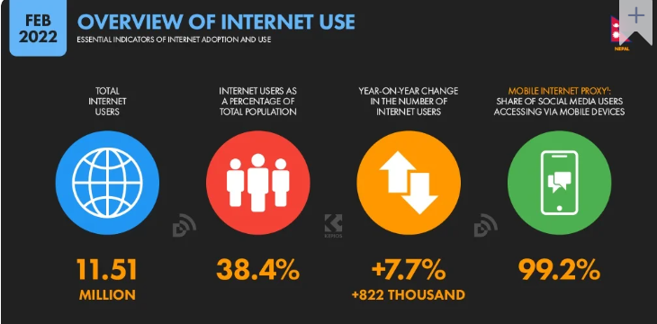

Slide 6
What can ICANN do to Nepal ?
New top level domain should be introduced
Work collaboratively with governments
Improvement in IPv6 which enable better connection
Promoting about the fundamental policies of ICANN in developing countries

Slide 7
Internet enabling policies
Promoting a collaborative security approach along with data protection laws
Promoting Local Content Hosting to Develop the Internet Ecosystem

Slide 8
Thank You

