Slide 1
Notes:
THERESA

Slide 2
GNSO Briefing on Key
Strategic Initiatives
12 October 2014
Notes:
THERESA

Slide 3
List of SI Projects
NTIA IANA Functions Stewardship Transition
Enhancing ICANN Accountability
Strategic and Operating Planning
Expert Working Group – Next Generation gTLD Directory Services
WHOIS Review Implementation & Improvements
GNSO Review
BWG/NomCom Report
ATRT2 – Implementation Update
Notes:
THERESA

Slide 4
NTIA IANA Functions’ Stewardship Transition
Notes:
THERESA

Slide 5
Meet the ICG
ICG Formed on 3 July
  30 community representatives + 2 liaisons
  Increased GAC representation to 5 members
Leadership Selected
  Chair: Alissa Cooper (IETF)
  Vice-Chairs: Patrik Fältström (SSAC) & Mohamed El Bashir (ALAC)
Modes of Operation Established
Two In-Person and 5 Virtual Meetings
Notes:
THERESA

Slide 6
ICG Milestones
27 Aug – Adopted Charter
Acknowledges relationship with accountability process
9 Sept – Request for Proposals (RFP) from Communities
  Complete formal responses from the “operational communities” of IANA functions due by 15 Jan 2015
9 Sept – Suggested Transition Process Timeline
9 Sept – RFP for Secretariat Function
18 Sept – Guidelines for Decision-Making
10 Oct - FAQs
Notes:
THERESA

Slide 7
CWG on Naming Related Functions
The CWG in formation – Co-chaired by Jonathan Robinson
  GNSO, ccNSO, ALAC, and SSAC formed a Drafting Team after London to develop a charter. All have since adopted the charter
  GAC has also adopted charter
The CWG is open to all – currently at 80 people (17 members; 63 participants)
Conscious of tight schedule– CWG had its first meeting on 6 October, and will meet again tomorrow afternoon. Frequent meeting schedule expected.
Notes:
THERESA

Slide 8
Enhancing ICANN Accountability
Notes:
THERESA

Slide 9
Developments Since London
ICANN ran a public comment process from 8 May to 27 June. Additional comments were received at ICANN50 and during consultation calls with the SO/AC/SG leadership.
Process posted on 14 August – followed by FAQ.
Community request for additional time
  On 26 August, community leaders sent a letter to Steve and Fadi requesting additional time. Response posted on 28 August.
  On 2 September, during ICANN Town Hall at IGF, discussion and acknowledgement of the need for additional time and community alignment from the onset of the process.
  On 3 September, community leader submitted follow up letter with questions about the process. Response provided on 18 September.
Additional Comment Period (6-27 September) – 21-day public comment period on the process, in response to community requests.
  17 comments were submitted, including a Joint SO/AC/SG/C Statement
Notes:
THERESA

Slide 10
Structure of Revised Process (10 Oct.)
Process revised to propose a CCWG with the following principles reflected:
  Up to 7 Advisors appointed by the Experts
  Board liaison selected by the Board
  ICANN staff
  ATRT expert selected from ATRT1 and ATRT2 participants
  IANA Stewardship Transition Coordination Group linkage
  Participation open to all
  Advisors, Board Liaison, Staff do not participate in any votes or calls for consensus.
  Role of the Board in relation to acceptance of recommendations from the process to be addressed by the Board.
  Scope and two work streams for immediate (IANA Transition) and long term accountability topics.
Notes:
THERESA

Slide 11
Structure of Revised Process (10 Oct.)
Scope of the accountability process – two work streams: The topic of accountability is important, and in the discussions around this process, areas and topics have been identified that are important to enhancing ICANN’s accountability but not directly related to accountability in the context of the changing historical relationship with the USG.
  To ensure that over time there’s a mechanism to ensure coverage of all areas, including topics outside of the immediate scope of the process, a suggestion is that the CWG establish two work streams or subgroups: one focused on the scope of the work on enhancing ICANN accountability in light of the changing relationship with the USG within the time frame of the transition (Work Stream 1); and a second focused on addressing topics on accountability outside the scope of Work Stream 1, which are longer term (Work Stream 2). This could be reflected in the CWG’s Charter.
Notes:
THERESA

Slide 12
Strategic and Operating Planning
Notes:
DENISE

Slide 13





Five Strategic Objectives - streamlined
      Evolve and further globalize ICANN.
      Support a healthy, stable and resilient unique identifier ecosystem.
      Advance organizational, technological and operational excellence.
      Promote ICANN’s role and multistakeholder approach.
      Advance ICANN’s global public responsibility within its mission and commitment to the public interest.
Notes:
DENISE

Slide 14
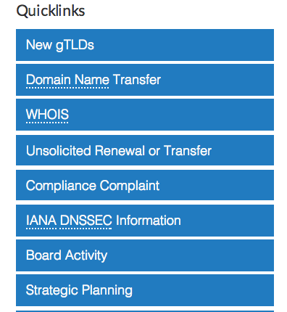
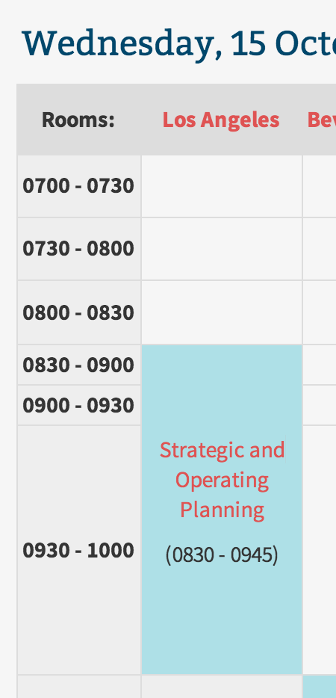

More Information...
www.icann.org
ICANN 51
Notes:
DENISE

Slide 15
ATRT2 Implementation Update
Notes:
LARISA

Slide 16
ATRT2 Implementation Update
Began in June 2014, upon Board’s approval
Project Management discipline:
      PMI standards, designed to achieve excellence
      Roles and responsibilities
      Project budgets and resources
Consistent implementation, including KPIs and metrics
Stakeholder updates each trimester:
      ICANN web site, wiki, public sessions, webinars
      Implementation Summaries
      Portfolio Management System
Notes:
LARISA

Slide 17
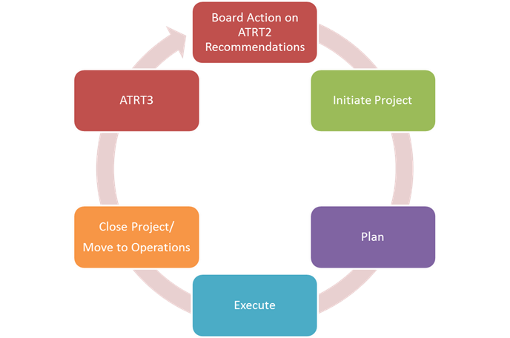
Project Management Discipline
Notes:
LARISA

Slide 18

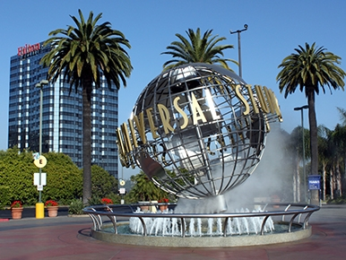



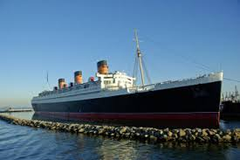



Questions & Answers
Notes:
THERESA

