Slide 1
GNSO Review Update
GNSO Council | 21 January 2016

Slide 2
GNSO Review Working Party
Business Constituency:
  Ron Andruff
Internet Service and Connectivity Providers Constituency:
  Osvaldo Novoa
  Wolf-Ulrich Knoben
Intellectual Property Constituency:
  Brian Winterfeldt
  Mike Rodenbaugh
Registry Stakeholder Group:
  Bret Fausett
  Chuck Gomes
  David Maher
Nominating Committee Appointees:
  Thomas Rickert
  Jennifer Wolfe
Non-Commercial Stakeholder Group:
  Avril Doria
  Rafik Dammak
  Klaus Stoll
  Rudi Vansnick
  Bill Drake
  Stephanie Perrin
Registrar Stakeholder Group:
  Jennifer Standiford
  Jeff Neuman
  Michele Neylon
  James M. Bladel (observer)
SO/AC Observers:
  No appointments at present
Other:
  Philip Sheppard

Slide 3
GNSO Review Working Party
Liaison between GNSO, independent examiner and OEC (previously SIC)
Provide input on review criteria and the 360 Assessment
Serve as conduit for input from GNSO
constituencies/ stakeholder groups, Council
Offer objective guidance & help to ensure the draft report accurately reflects the GNSO structure, scope and dynamics
Coordinate preparation of an Implementation Plan and champion
implementation of improvement activities
Perform support communication/
awareness activities to encourage participation
More information at https://community.icann.org/x/X5LhAg
Notes:
The GNSO Review Working Party was tasked with several responsibilities over the past 21 months. One of the final tasks for this Review is to “coordinate preparation of an Implementation Plan and champion implemental of improvement activities”.

Slide 4
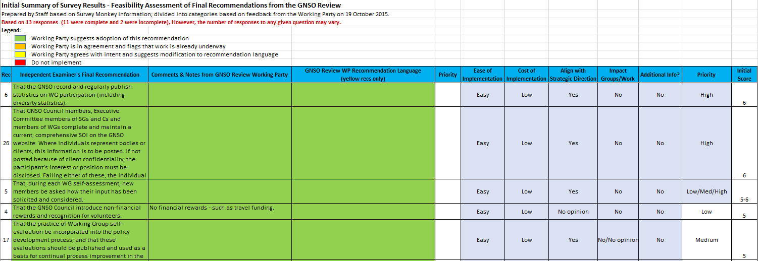
Feasibility and Prioritization
Initial review of 36 recs completed;
Prioritization and final assessment underway
Notes:
Snapshot of some of the recommendations and how they were prioritized based on the results of the Working Party’s input.

Slide 5
GNSO Review Timeline
15 Sept
Oct 2015 – Feb 2016
Feb/Mar 2016*
Mar 2016
June 2016
Next
Steps
Westlake Final Report sent to OEC and posted on icann.org
GNSO Review WP provides final input on feasibility & implementation
GNSO Council to vote on the Working Party’s Final Assessment and Prioritization
OEC considers feasibility assessment, makes recommendation to the Board
ICANN Board action on Final Report
Update:
GNSO Review Working Party to complete assessment and prioritization of 36 Recommendations in February 2016 and submit its report to the OEC.
The OEC will make a recommendation to the Board at ICANN55; the ICANN Board will take action on the Final Report by ICANN56.
GNSO Council may vote in February, if their schedule permits; otherwise the vote will occur at ICANN55.

Slide 6


Useful Links and Q&A
Thank You and Questions
GNSO Review Working Party Home Page
Independent Examiner Information
Final Report of Independent Examiner
GNSO Review Working Party Activities, Milestones and Statistics
Summary and Resolution of Working Party Comments

