Slide 1
Student-run Network Operations
Korry Luke
koluke@sfc.wide.ad.jp
Keio University
ICANN64 NextGen - March 2019

Slide 2
In a nutshell
Our lab network is completely separated from the both the rest of our campus and university as a whole, and is operated and managed almost entirely by our students and researchers
This creates a unique environment for students to gain real-world, hands-on experience in network operations

Slide 3
Some of the services we operate
Email for laboratory members
IP address allocation/primary DNS
Wired and wireless network connectivity within our lab building space
Virtual server hosting for experiments, etc.
Many of our lab group members also participate in other events such as Keio’s annual Open Research Forum and ShowNet/Interop Tokyo

Slide 4
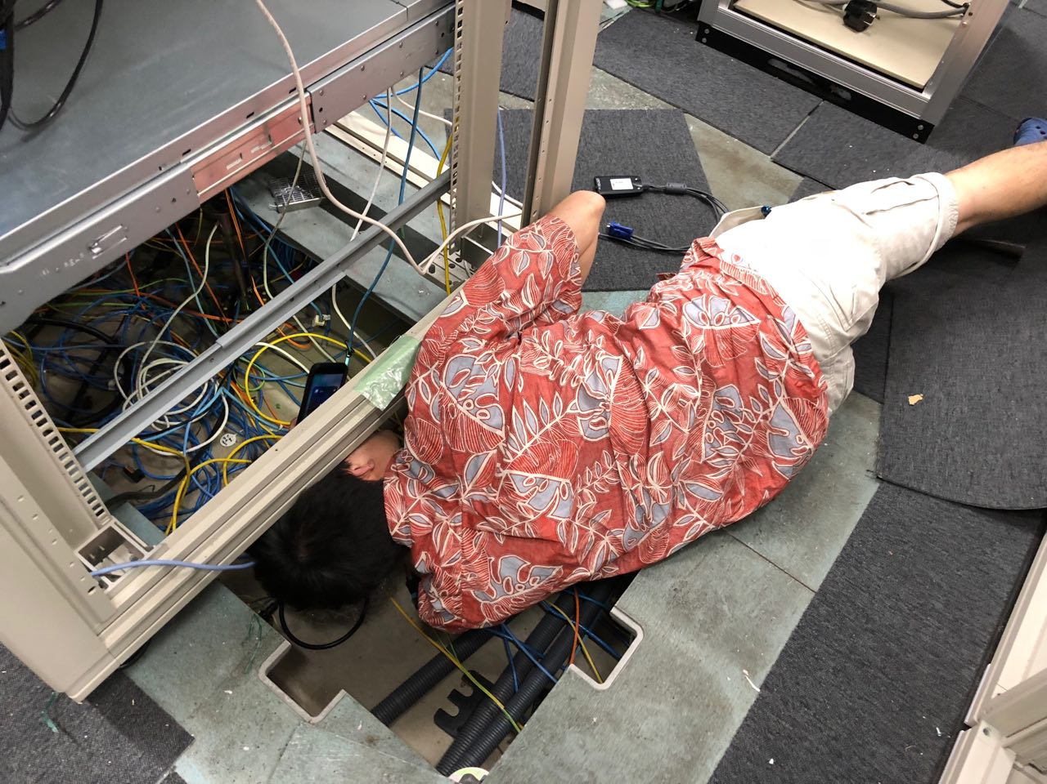
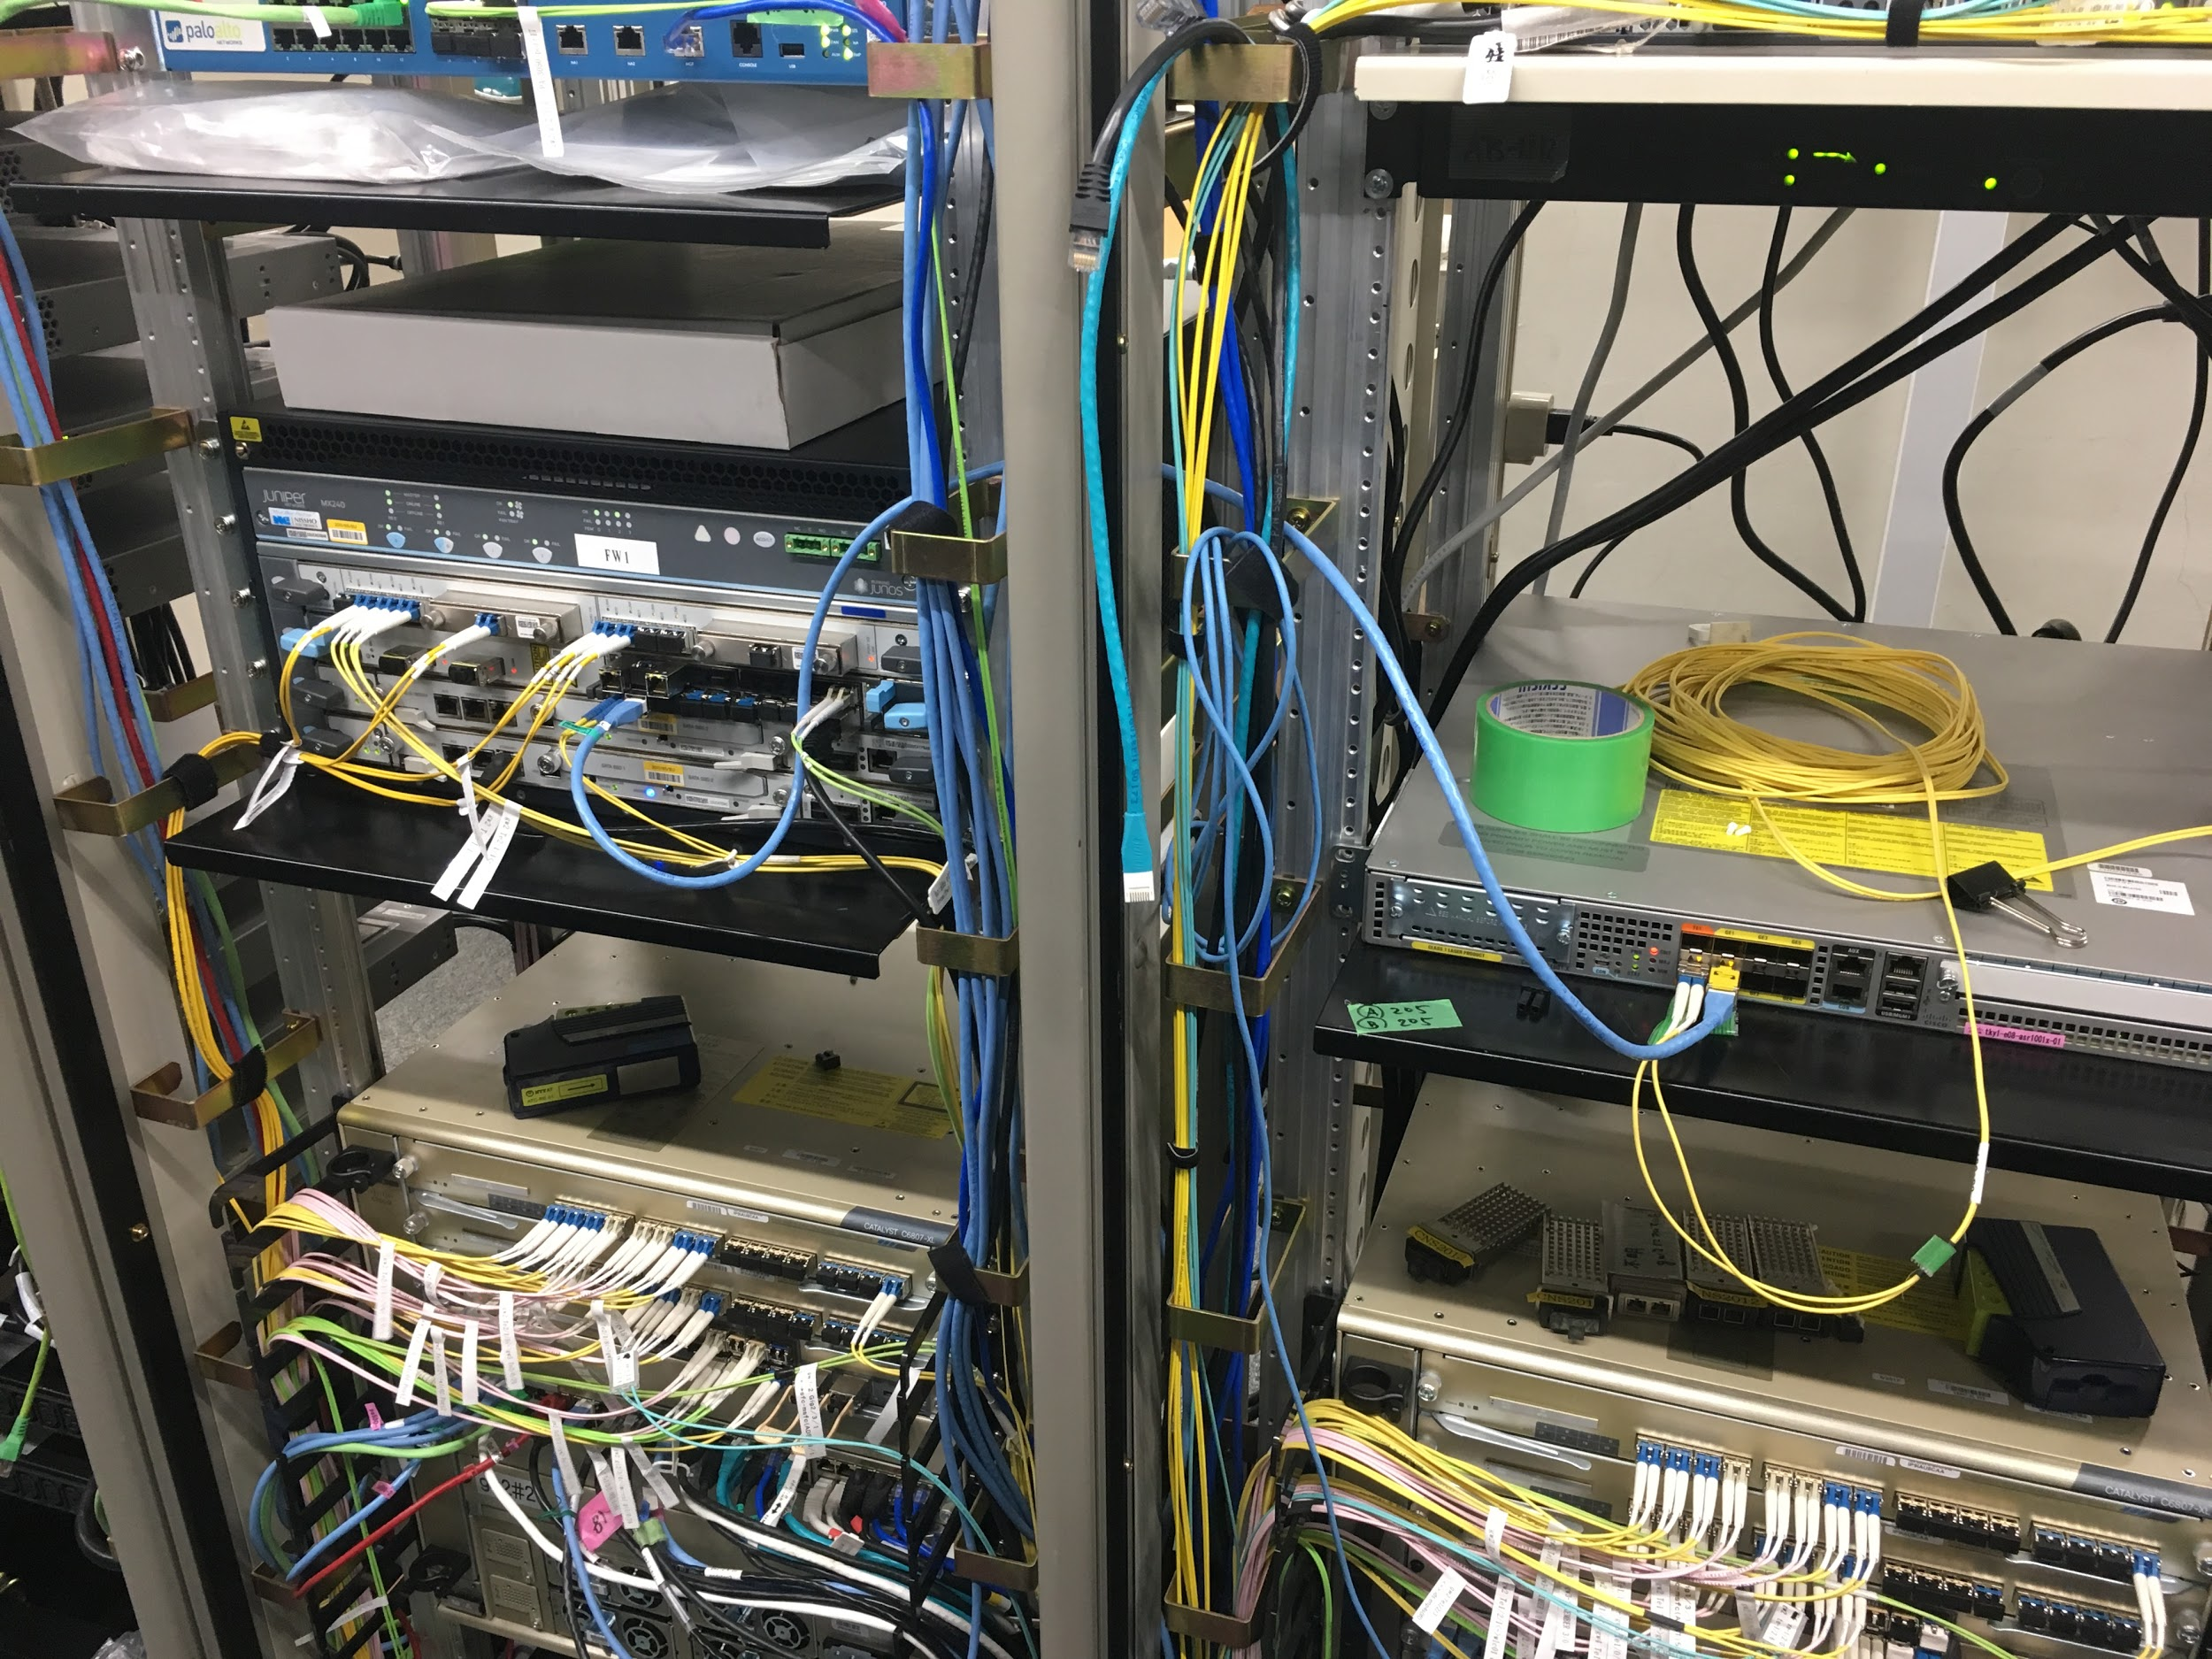
Examples of our work

Slide 5
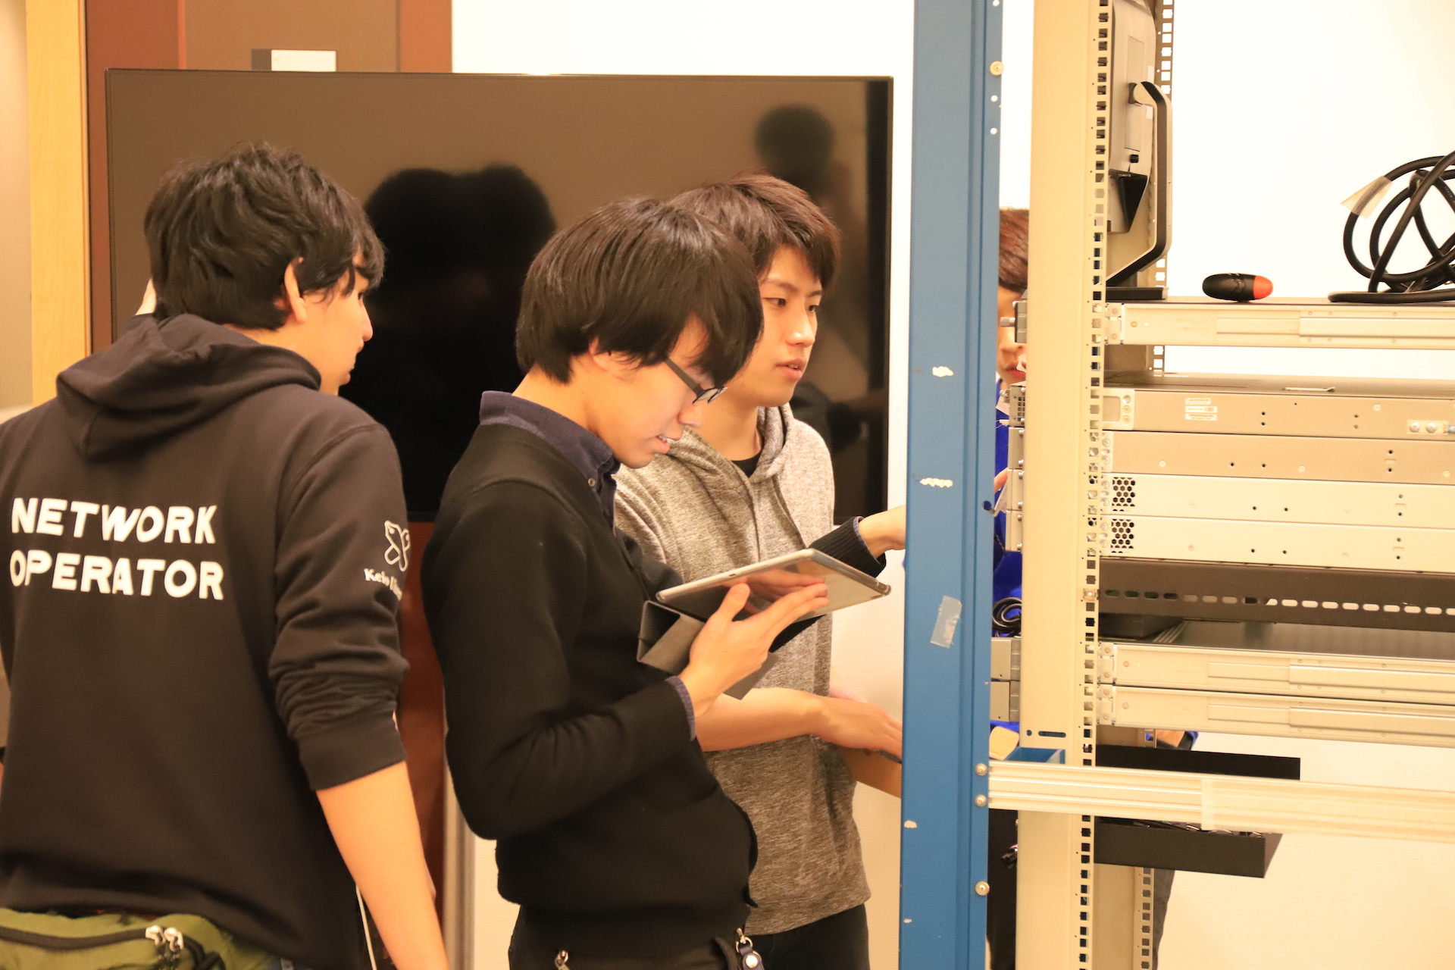
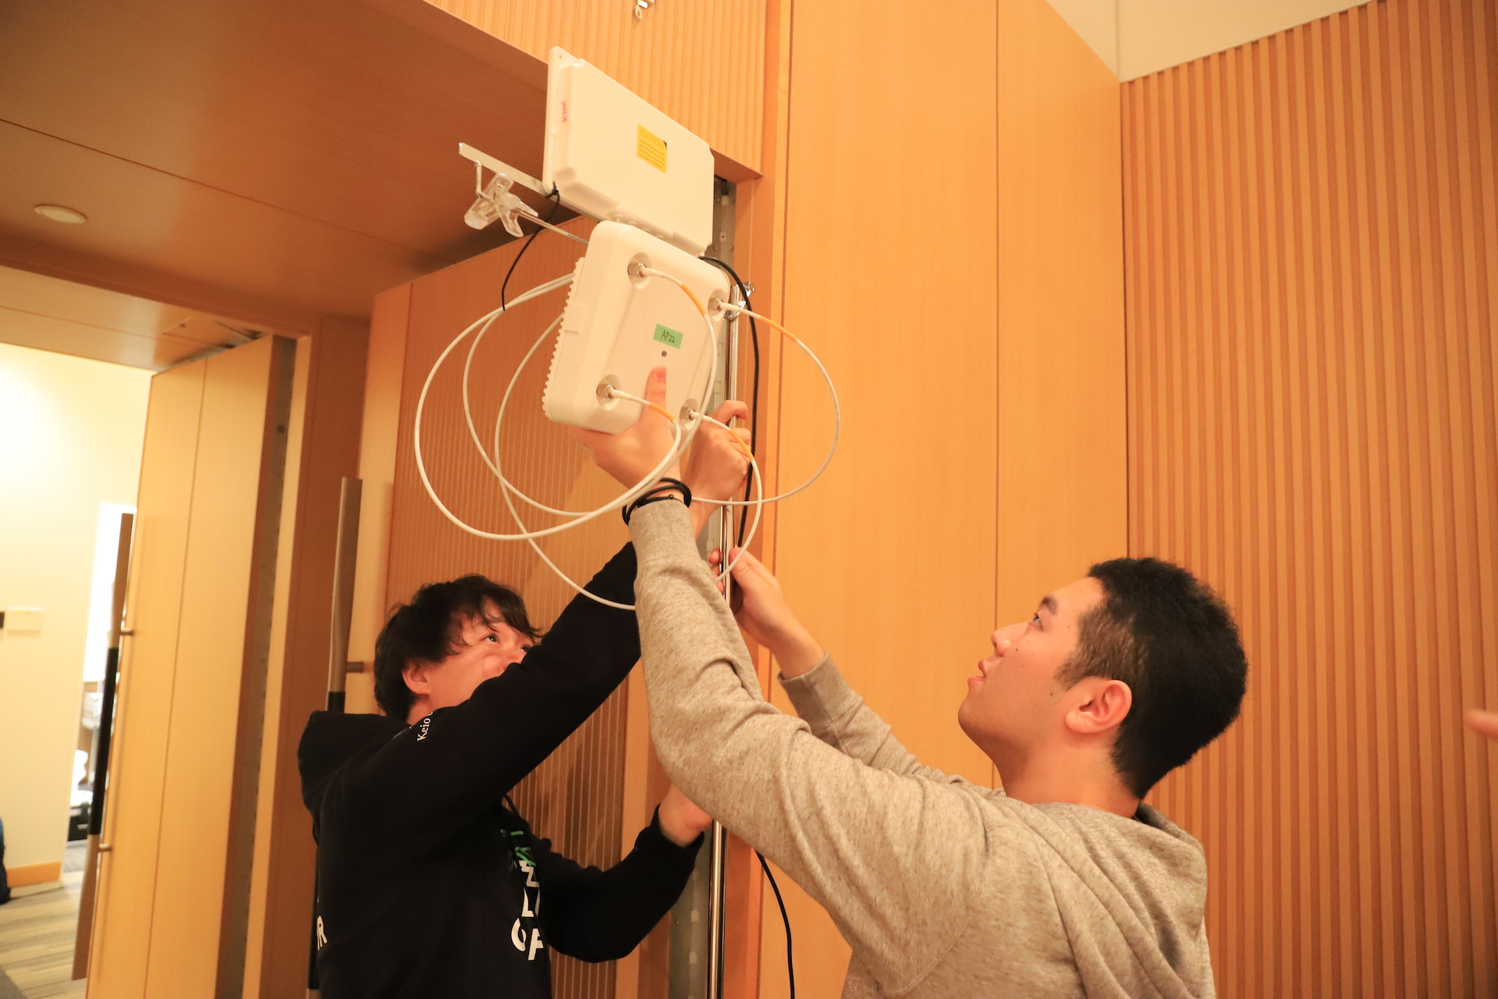
Keio’s annual Open Research Forum Network Operations Center (ORF-NOC) team

Slide 6
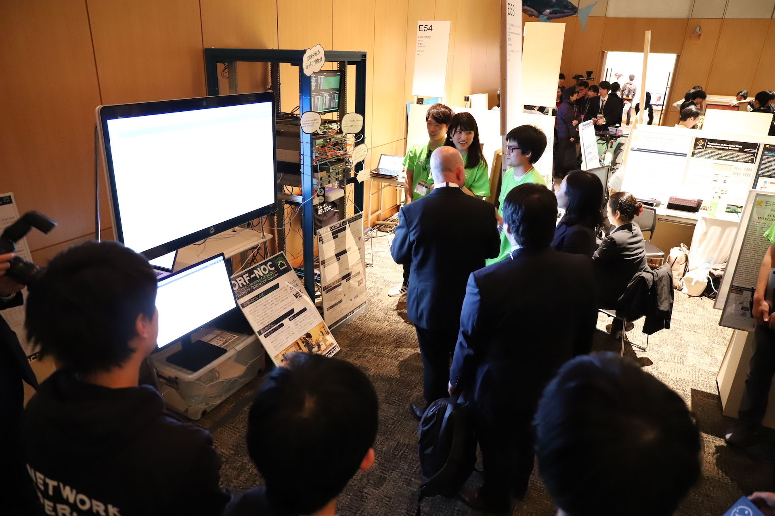
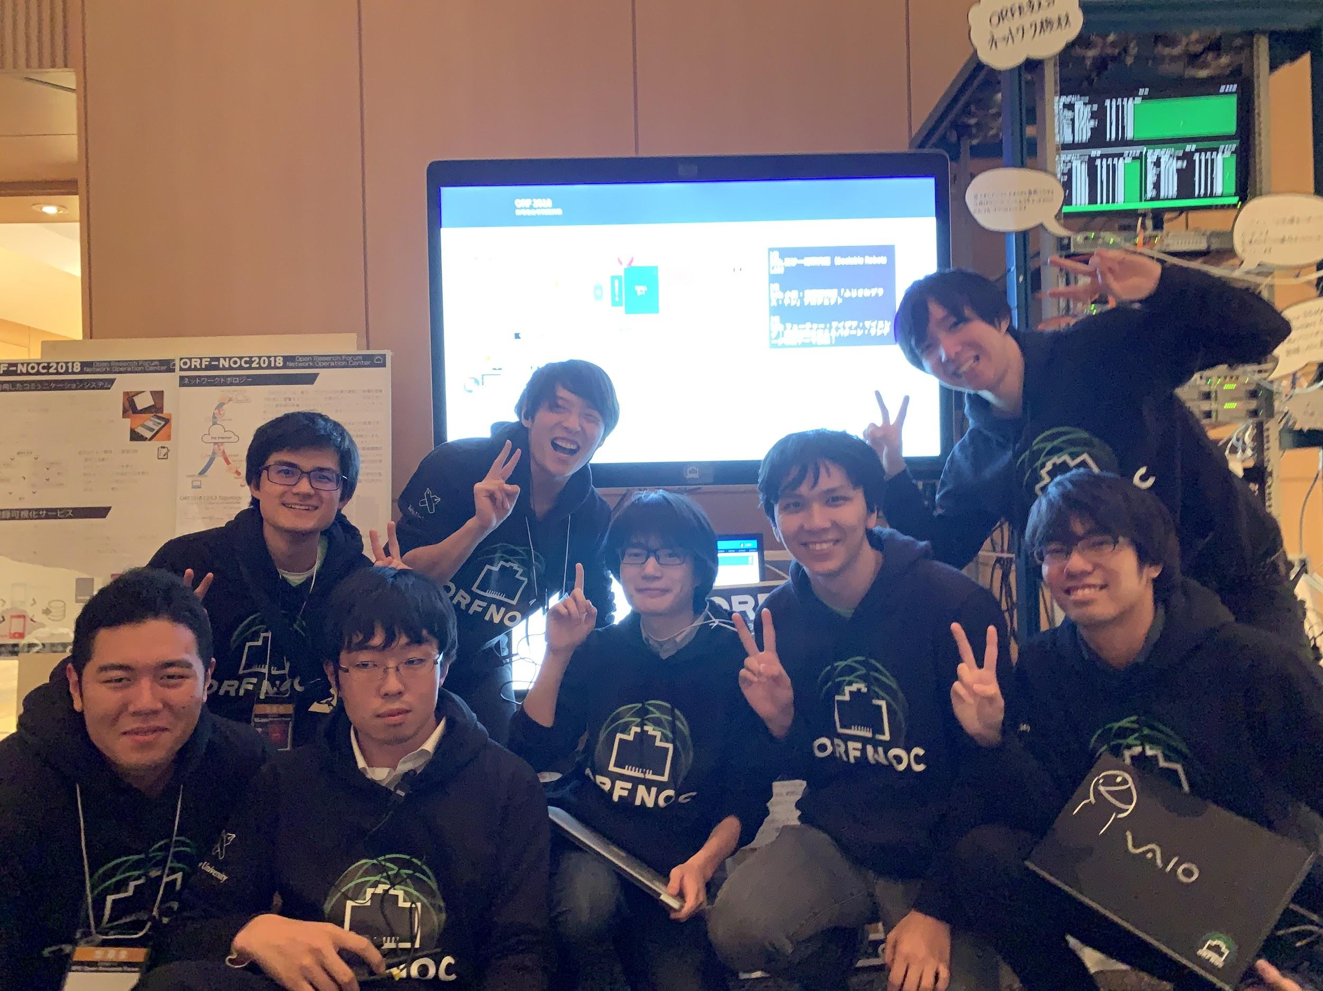
Keio’s annual Open Research Forum Network Operations Center (ORF-NOC) team

Slide 7
Benefits of student-run operations
Ability to control/modify anything and everything
Sense of pride, responsibility, and trust
Real-world operations and deployment experience
  Usable even after finishing college
  Marketable job skill
Deeper understanding by administering vs. simply using services
Independence to make mistakes/try new things
  Free from bureaucracy of being attached to a large university
  Run a service → find a problem → experiment → propose a solution → research!

Slide 8
Drawbacks of doing it ourselves
Can be challenging for newcomers/beginners
Managing user expectations of student-managed vs. professionally-managed
  No SLA, guaranteed uptime, etc.
  Internet principle of “best effort”
  Research vs. operations
Technology is continually evolving
  How to provide better service without creating more work/stress for administrators
  How to “pass the torch” effectively as seniors graduate

Slide 9
Some challenges and future work
Modernizing our infrastructure
Comparison of cloud services vs. on-premises
Generally speaking, research and operations are different
Attracting newcomers and keeping interest as technology evolves
Documentation! (and configuration management)

