Slide 1
KSK Futures Discussion
Paul Hoffman, organizer
ICANN 64, Kōbe
13 March 2019

Slide 2
Why we are here
The process of rolling over KSK for the root zone was begun in 2015
The new key was put into use on 11 October 2018, and the old key will be removed on 22 March 2019
A lot of surprising things were found during the rollover process
White paper covering the process
  https://www.icann.org/review-2018-dnssec-ksk-rollover.pdf
What have we learned about rolling over the KSK that we can apply to future rollovers?
  There is already a wide variety of views expressed

Slide 3
Next steps
Discussion is already happening on the mailing list
  Subscribe and review the archives at https://mm.icann.org/mailman/listinfo/ksk-rollover
Saying things here today is definitely useful, but it will be even more useful if whatever you say is also brought to the mailing list so that a wider audience can see it and discuss it
  This can be more about group discussion than individual’s statements.
In the second half of 2019, IANA will review the discussion, evaluate the proposals, prepare a draft plan, and bring that plan to the community for public review

Slide 4
DNSKEY queries seen at most of the root servers
Increases in the volume of root DNSKEY requests after the rollover, and again after the revocation
No seeming impact: there have been no complaints
Not clear if these systems have any users making queries or if they are just on autopilot

Slide 5
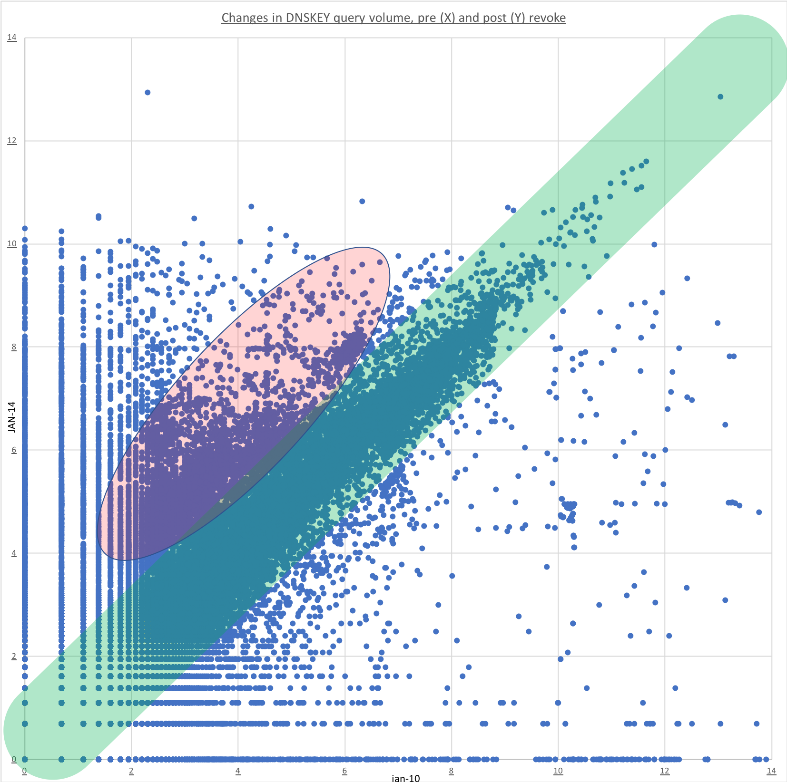
Before and after the revocation of KSK-2010
This chart shows the change in root DNSKEY query rates before and after 11 January 2019
The green band are hosts asking for the root DNSKEY at about the same rate before and after the revocation.
There are a lot of hosts asking for the DNSKEY (pink area) that were not asking before, and only a few asking less frequently

Slide 6
Some of the previous comments
Why roll at all? What are the motivations?
How often to roll? (Every X years, or until it is proven to be needed)
Need better tools to say when resolvers are ready for an upcoming rollover
Need better bootstrapping for the resolvers that are running up-to-date software
Should there be standby keys? If so, what are the important considerations?
Should the signing algorithm change? If so, what are the important considerations?

Slide 7
Let’s discuss
Make your proposal or ask your question, but also consider responding to earlier discussion
It’s OK to bring up something completely new
Getting DNSSEC widely deployed has been difficult: will your suggestion cause it to be easier or harder to get more zones signing and more resolvers validating?
Again: after this meeting, please take your ideas to the mailing list

Slide 8






Engage with ICANN
Thank You and Questions
Visit us at icann.org
Participate: https://mm.icann.org/mailman/listinfo/ksk-rollover
@icann
facebook.com/icannorg
youtube.com/icannnews
flickr.com/icann
linkedin/company/icann
slideshare/icannpresentations
soundcloud/icann

